Slide 1


Machine learning Workshop

Slide 2

TODAYS AGENDA
Prerequisites for this Workshop
What is AI, ML and DL?
Types Of Machine Learning
Machine Learning Pipeline
Linear Regression
Regression Metrics
Logistic Regression
Classification Metrics

Slide 3

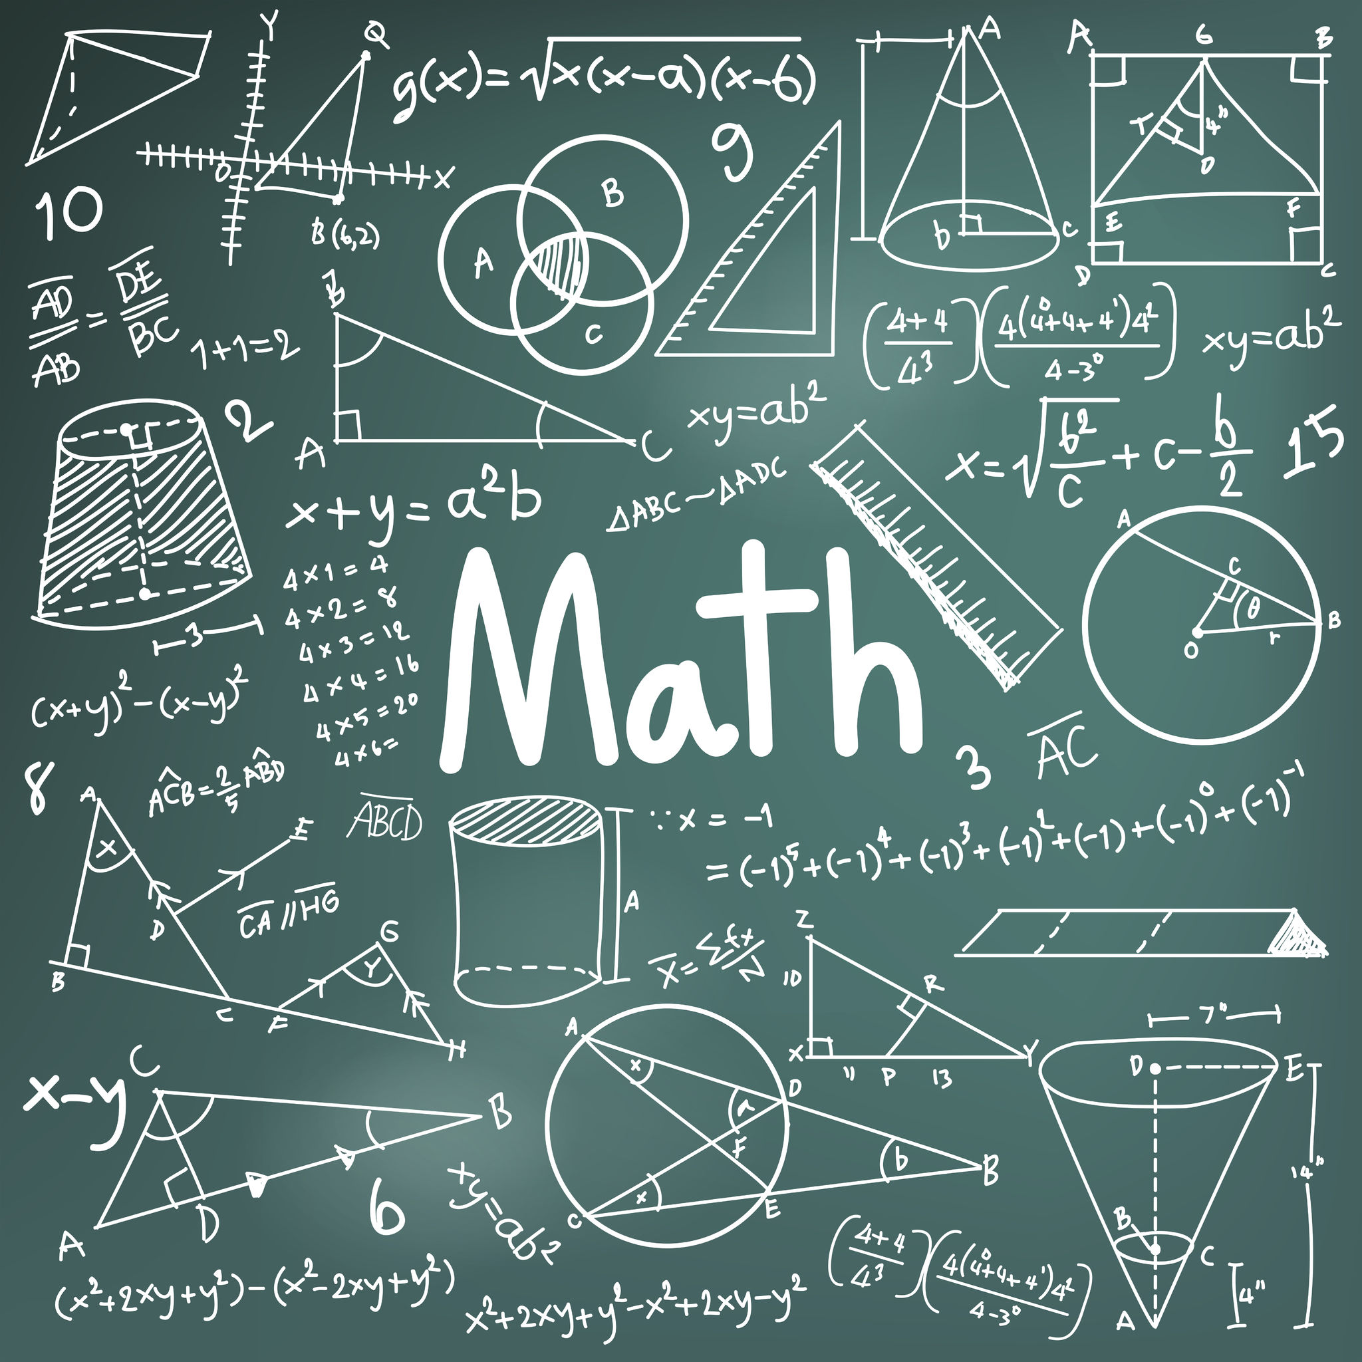
Prerequisites for this workshop

Slide 4


EYeS AND EARS AND HANDS

Slide 5
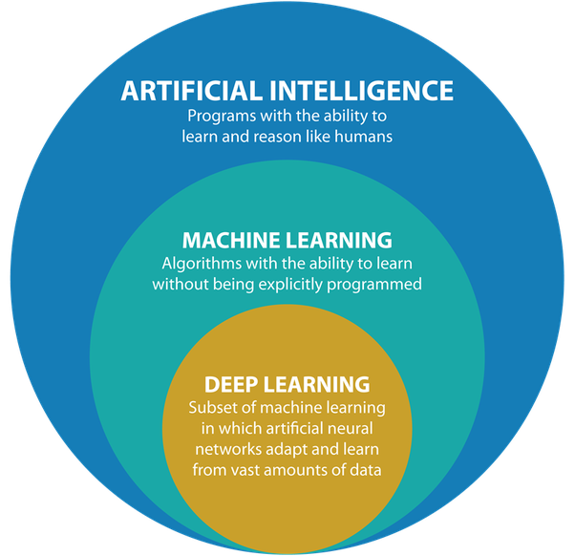
AI & ML & DL
Artificial Intelligence (AI): Artificial intelligence is the simulation of human intelligence processes by machines, especially computer systems.
Machine Learning (ML): Machine learning is the study of computer algorithms that can improve automatically through experience and by the use of data. It is seen as a part of artificial intelligence.
Deep Learning (DL): Deep learning is a type of machine learning and artificial intelligence (AI) that imitates the way humans gain certain types of knowledge.

Slide 6
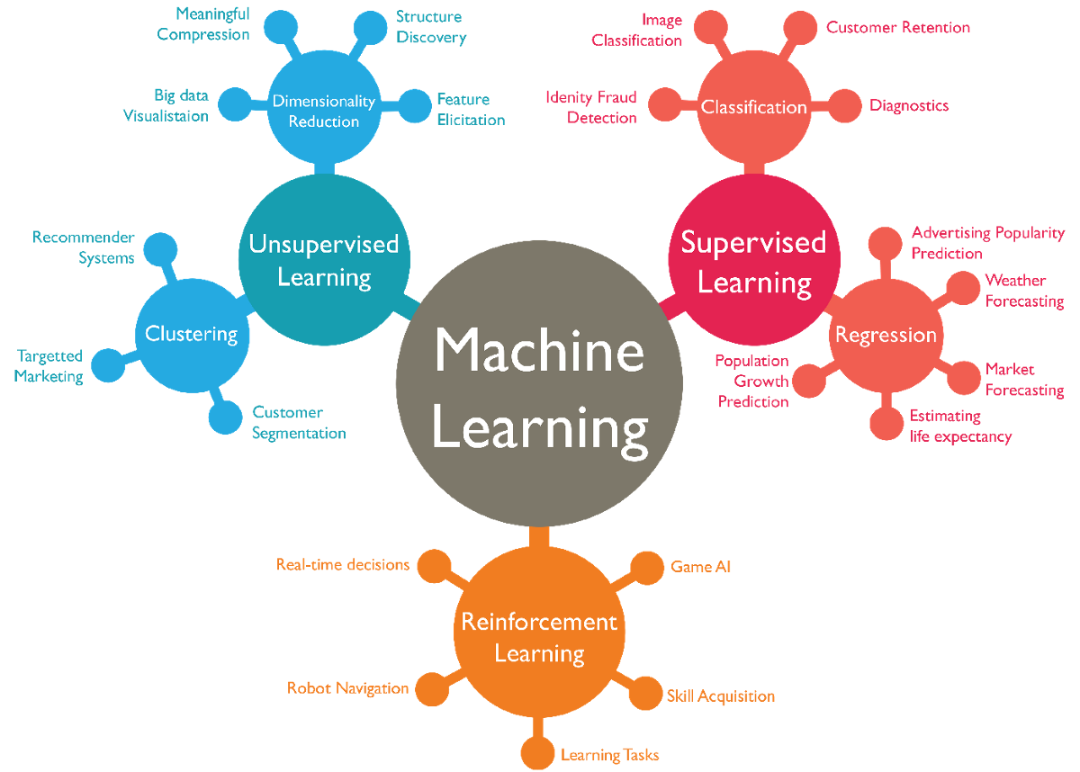
Types of machine learning

Slide 7
Supervised and unsupervised learning
Supervised learning: It is a type of machine learning in which machines are trained using well "labelled" training data, and on basis of that data, machines predict the output. Supervised learning is a process of providing input data as well as correct output data to the machine learning model.
Unsupervised learning: Unsupervised learning, also known as unsupervised machine learning, uses machine learning algorithms to analyze and cluster unlabeled datasets. These algorithms discover hidden patterns or data groupings without the need for human intervention.

Slide 8
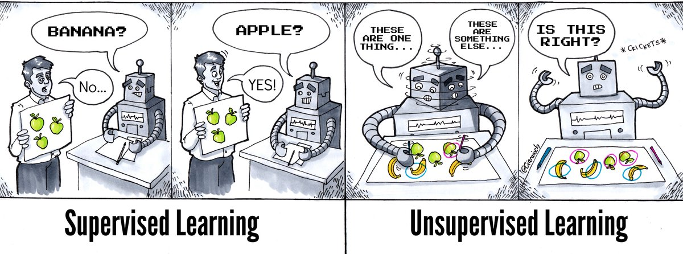
BEST EXAMPLE

Slide 9

Reinforcement learning
Reinforcement learning is a machine learning training method based on rewarding desired behaviour and/or punishing undesired ones. In general, a reinforcement learning agent is able to perceive and interpret its environment, take actions and learn through trial and error​It is about learning the optimal behavior in an environment to obtain maximum reward.

Slide 10
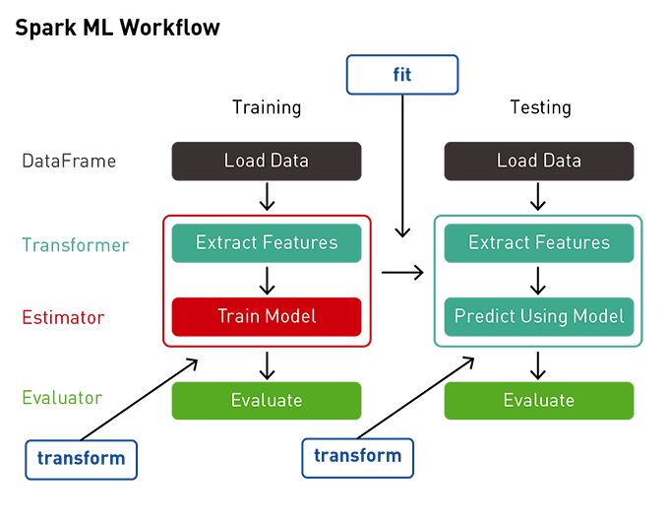
Machine learning pipeline

Slide 11

Linear regression

Slide 12
What is linear regression
Linear Regression is the supervised Machine Learning model in which the model finds the best fit linear line between the independent and dependent variable i.e it finds the linear relationship between the dependent and independent variable.
Linear Regression is of two types: Simple and Multiple.
Simple Linear Regression is where only one independent variable is present and the model has to find the linear relationship of it with the dependent variable
Whereas, In Multiple Linear Regression there are more than one independent variables for the model to find the relationship.

Slide 13
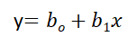
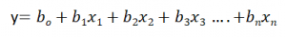
Simple and multiple linear regression
Equation of Simple Linear Regression, where b_{o} is the intercept, b₁ is coefficient or slope, x is the independent variable and y is the dependent variable.
Equation of Multiple Linear Regression, where bo is the intercept, b₁,b₂,b₃,b₄…,b_{n} are coefficients or slopes of the independent variables x₁,x₂,x₃,x₄…,x_{n} and y is the dependent variable.

Slide 14
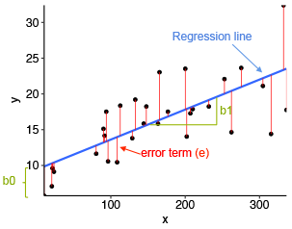
Understanding by visualizing

Slide 15
Gradient descent
Article: https://www.geeksforgeeks.org/how-to-implement-a-gradient-descent-in-python-to-find-a-local-minimum/

Slide 16
REGRESSIOn metrics
Article: https://medium.com/analytics-vidhya/evaluation-metrics-for-regression-algorithms-along-with-their-implementation-in-python-9ec502729dad

